Slide 1
Topic 8
Introduction to NoSQL Database
SECD2523 Database
Semester 1 2022/2023

Slide 2
Learning Objective
After completing this chapter, you will be able to:
  Summarize the four major approaches of the NoSQL data model and how they differ from the relational model

Slide 3
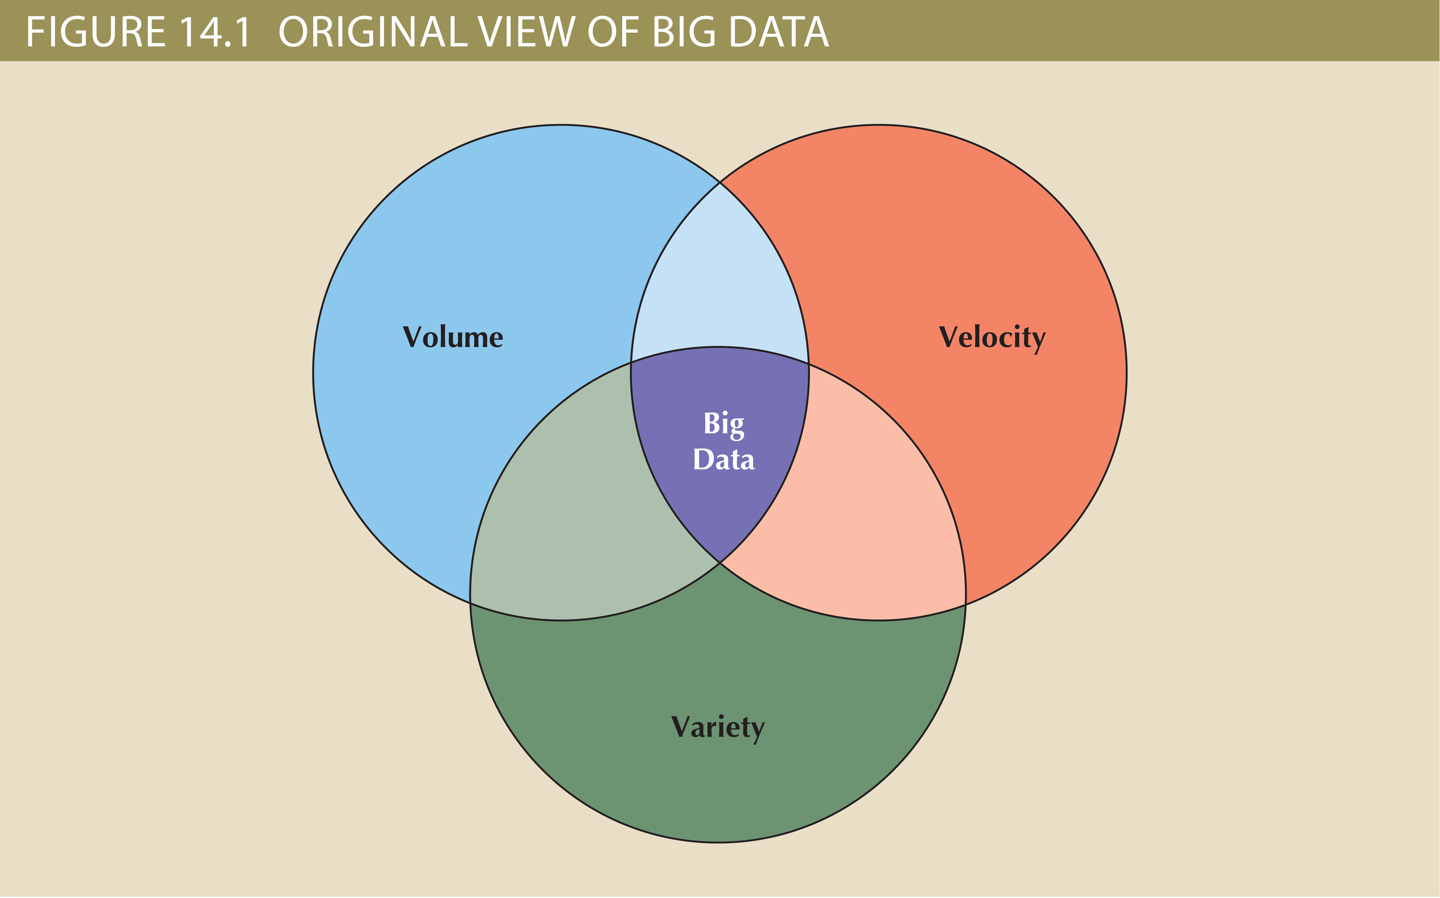
Towards Big Data…

Slide 4
Towards Big Data…
Volume: quantity of data to be stored
  Scaling up: keeping the same number of systems but migrating each one to a larger system
  Scaling out: when the workload exceeds server capacity, it is spread out across a number of servers
Velocity: speed at which data is entered into system and must be processed
  Stream processing: focuses on input processing and requires analysis of data stream as it enters the system
  Feedback loop processing: analysis of data to produce actionable results
Variety: variations in the structure of data to be stored
  Structured data: fits into a predefined data model
  Unstructured data: does not fit into a predefined model

Slide 5
Towards Big Data…
Other characteristics
  Variability: changes in meaning of data based on context
  Sentimental analysis: attempts to determine if a statement conveys a positive, negative, or neutral attitude about a topic
  Veracity: trustworthiness of data
  Value: degree data can be analyzed for meaningful insight
  Visualization: ability to graphically resent data to make it understandable
Relational databases are not necessarily the best for storing and managing all organizational data
  Polyglot persistence: coexistence of a variety of data storage and management technologies within an organization’s infrastructure

Slide 6
NoSQL
NoSQL: non-relational database technologies developed to address Big Data challenges. Four major approaches: Key-value DB, document DB, column-oriented DB, Graph DB.
Key-value (KV) DB
Document DB
Column-oriented DB
Graph DB
conceptually the simplest of the NoSQL data models
Store data as a collection of key-value pairs organized as buckets which are the equivalent of tables
like key-value databases and can almost be considered a subtype of KV databases
Store data in key-value pairs in which the value components are encoded documents grouped into large groups called collections
two technologies:
Column-centric storage: data stored in blocks which hold data from a single column across many rows
Row-centric storage: data stored in block which hold data from all columns of a given set of rows
store data on relationship-rich data as a collection of nodes and edges
Properties: like attributes; they are the data that we need to store about the node
Traversal: query in a graph database

Slide 7
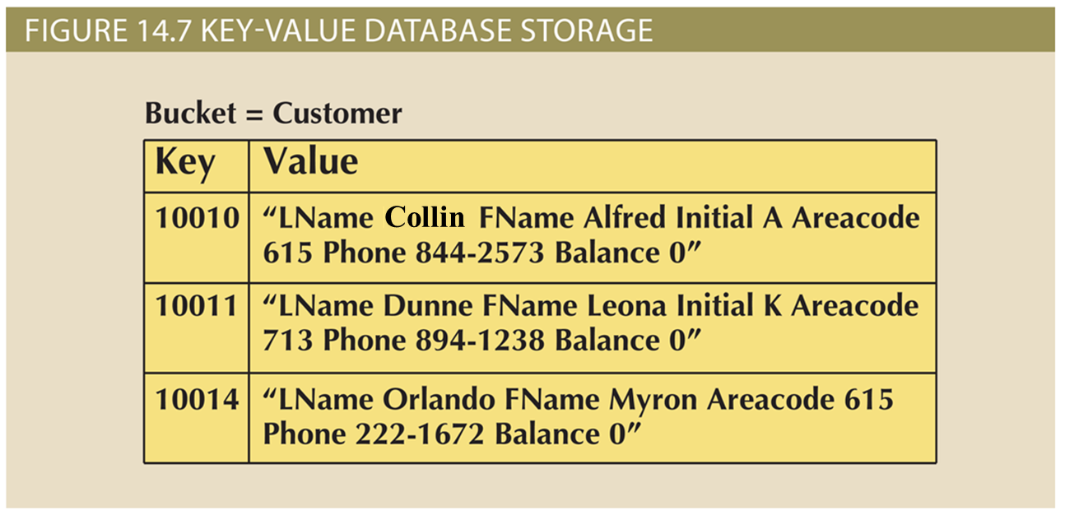
Example: Key-value (KV) DB

Slide 8
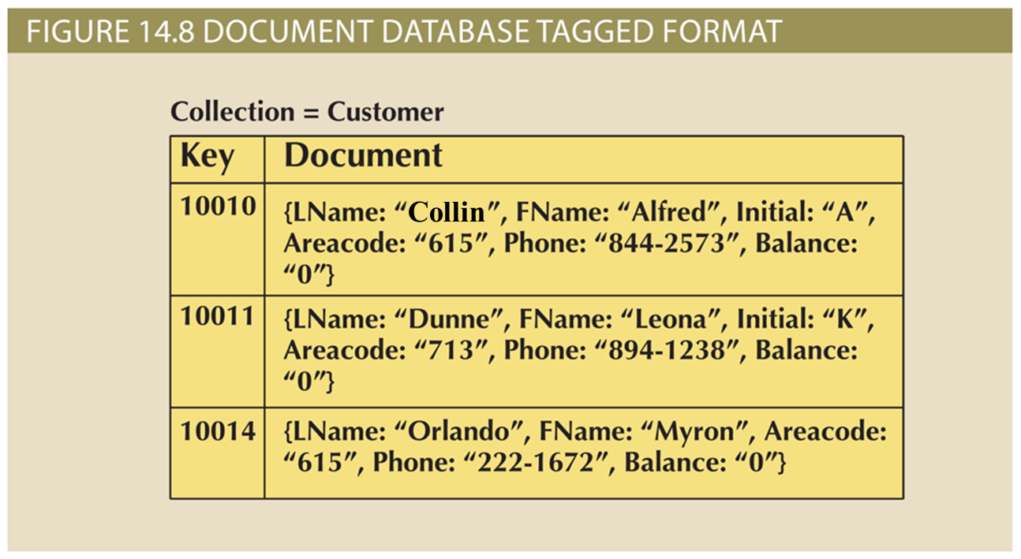
Example: Document DB

Slide 9
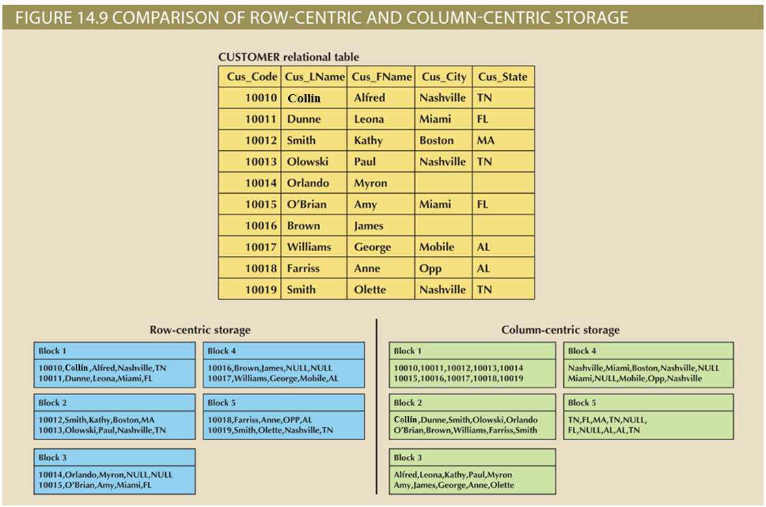
Example: Column-oriented DB

Slide 10
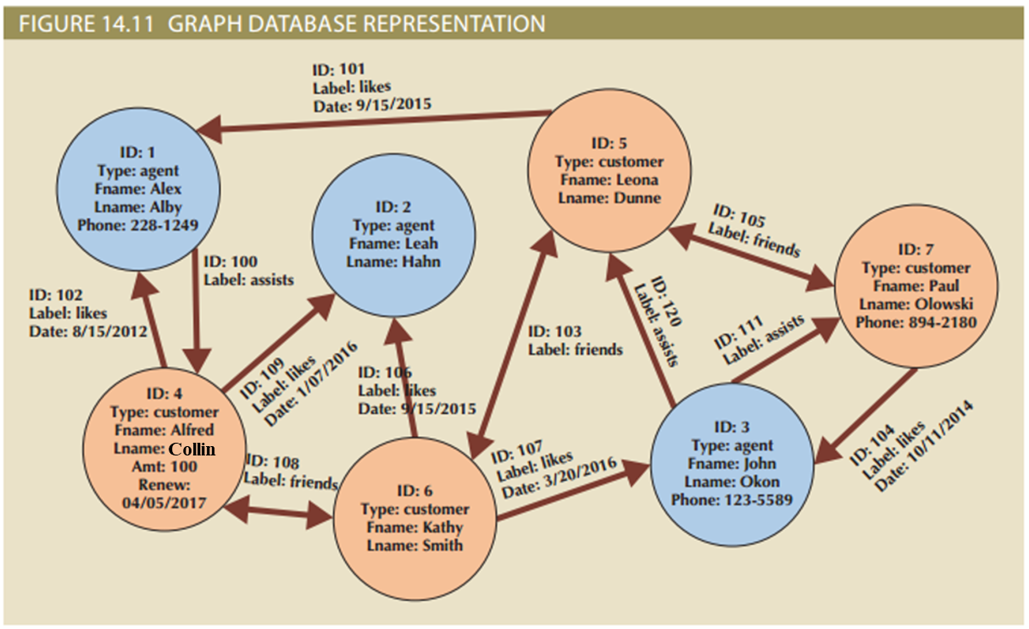
Example: Graph DB

Slide 11
Summary
Big Data is characterized by data of such volume, velocity, and/or variety that the relational model struggles to adapt to it
Volume, velocity, and variety are collectively referred to as the 3 Vs of Big Data
NoSQL is a broad term to refer to any of several nonrelational database approaches to data management
Key-value databases store data in key-value pairs
Document databases also store data in key-value pairs, but the data in the value component is an encoded document
Column-oriented databases, also called column family databases, organize data into key-value pairs in which the value component is composed of a series of columns, which are themselves key-value pairs
Graph databases are based on graph theory and represent data through nodes, edges, and properties

